Slide 1
CHATBOT WITH CHATGPT
-PRUTHVI NIRANJAN

Slide 2
PROBLEM STATEMENT
Modern travelers seek instant information and seamless booking experiences. Travel agents need efficient systems to provide quick responses and personalized services.
To develop a web-based chatbot for a travel agent company that can handle user queries about travel information and specific travel packages which seperates propriety data from general questions.

Slide 3
DATA SOURCE
General Travel Information:
OPENAI API
Database Specific Information:
SQLITE DATABASE
flights: Stores flight details, including departure and arrival cities, class, price, and currency.
hotels: Contains hotel information such as city, star rating, price per night, and currency.
packages: Includes travel package details like destination, type, price, and currency.
tours: Lists tour options with location, type, price, and currency.
cruises: Stores cruise details including destination, duration, price, and currency.
car_rentals: Contains car rental options with city, price per day, and currency.

Slide 4
TECHNICAL APPROACH
Frontend: React
React: Built a dynamic, responsive user interface to handle user interactions and present responses.
Components: Structured into reusable components for easy maintenance and scalability.
State Management: Utilized React's state and context APIs to manage application state.
Backend: Flask
Flask: Set up a lightweight web server to handle API requests from the frontend.
Endpoints: Created RESTful endpoints for processing user queries and fetching data from the database.
Integration: Seamlessly integrated with the frontend for smooth data flow.

Slide 5
Natural Language Processing (NLP):
NLTK: Employed Natural Language Toolkit for keyword extraction and processing user queries.
Naive Bayes Classifier: Implemented to classify user queries into general or proprietary categories.
General Queries: Questions like travel time or distance between cities, handled using OpenAI's API.
Proprietary Queries: Questions about travel packages, costs, etc., specific to the travel agent.
Database: SQLite
SQLite: Used for storing and retrieving travel package information.
Data Modeling: Structured tables for flights, hotels, packages, tours, cruises, and car rentals.
Querying: Employed SQL commands, generated using OpenAI, to fetch relevant data based on user queries.
Integration with OpenAI:
OpenAI API: Leveraged for handling general queries by providing direct answers.
SQL Command Generation: Utilized OpenAI to generate valid SQL commands for proprietary queries.

Slide 6
IMPLEMENTATION
Frontend Development
React Components: Developed interactive UI components for user interaction.
API Integration: Connected frontend to backend via RESTful API endpoints.
User Experience: Ensured a responsive and intuitive user interface.
Backend Development
Flask API: Created endpoints to handle incoming queries.
Data Processing: Managed data flow between frontend, NLP processing, and database queries.
NLP Processing
Keyword Extraction: Implemented NLTK for extracting relevant keywords from user queries.
Query Classification: Used Naive Bayes to classify queries into general or proprietary categories.

Slide 7
Handling Queries
General Queries: Utilized OpenAI API to respond to general knowledge questions.
Proprietary Queries: Generated SQL commands using OpenAI, executed on SQLite database for specific travel-related information.
Response Generation
Result Compilation: Combined results from OpenAI and SQLite queries.
Frontend Display: Sent compiled responses back to the frontend for user display.

Slide 8
IDENTIFICATION OF QUERY
User query
IDENTIFY TYPE OF QUERY
general
OPENAI response
NLP TECHNIQUES TO FETCH KEYWORDS
propriety
NAÏVE BAYES CLASSIFIER
Generate sql query using GPT
Execute query and send it back to API for response

Slide 9
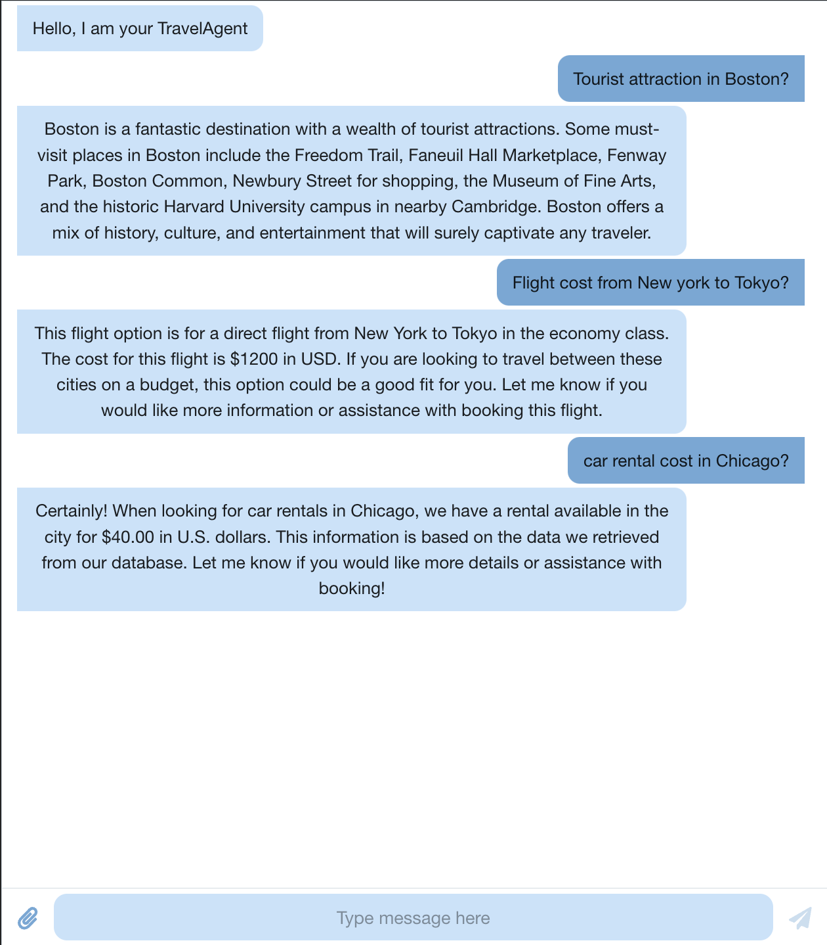
RESULTS

Slide 10
CONCLUSION
Enhancements: Potential improvements in SQL query generation, model and database optimization.
Context management.
Features: Adding more functionalities like voice interaction and multi-language support.

